Slide 1


OpenSim – Python
Hernandez Vincent

Slide 2
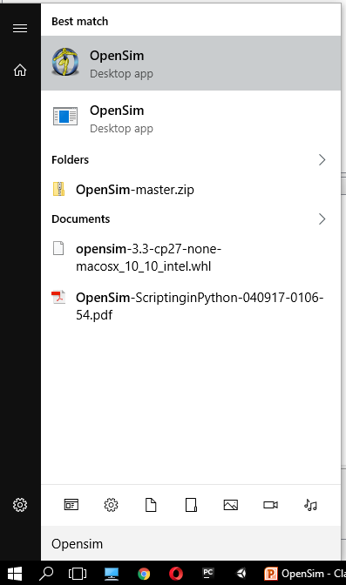
2
Let’s open OpenSim

Slide 3
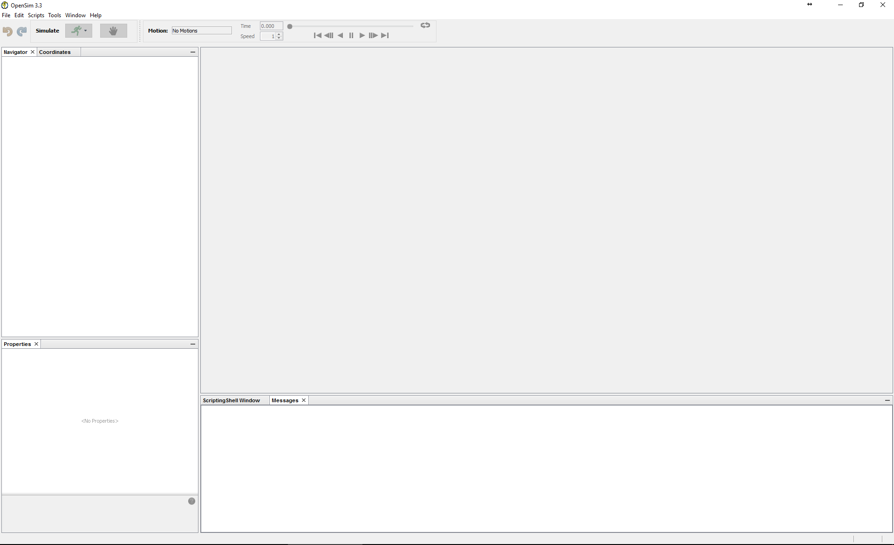
3
OpenSim Interface

Slide 4
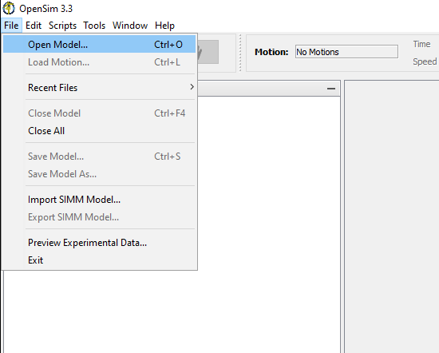
4
Open a musculoskeletal model

Slide 5
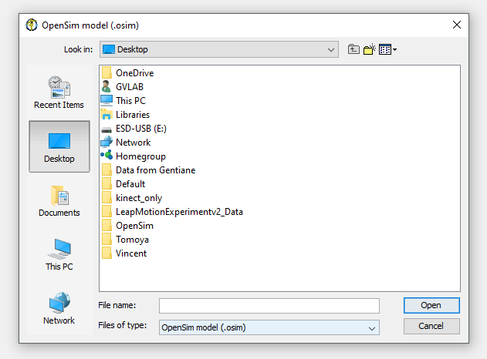
5
Open a musculoskeletal model

Slide 6
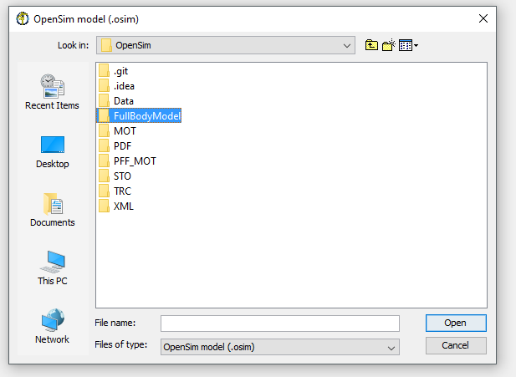
6
Open a musculoskeletal model

Slide 7
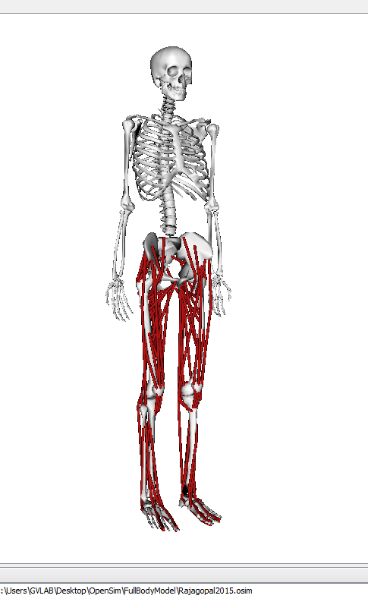
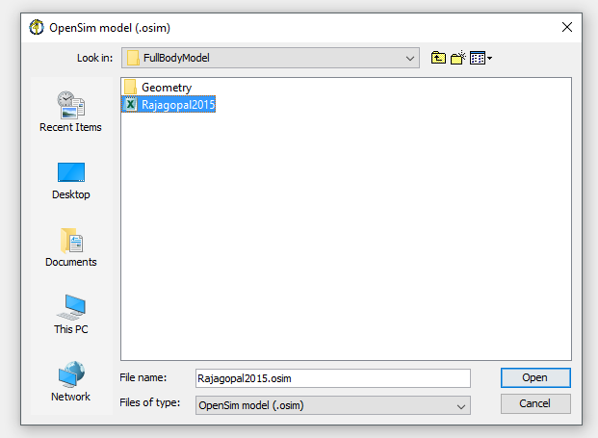
7
Open a musculoskeletal model

Slide 8
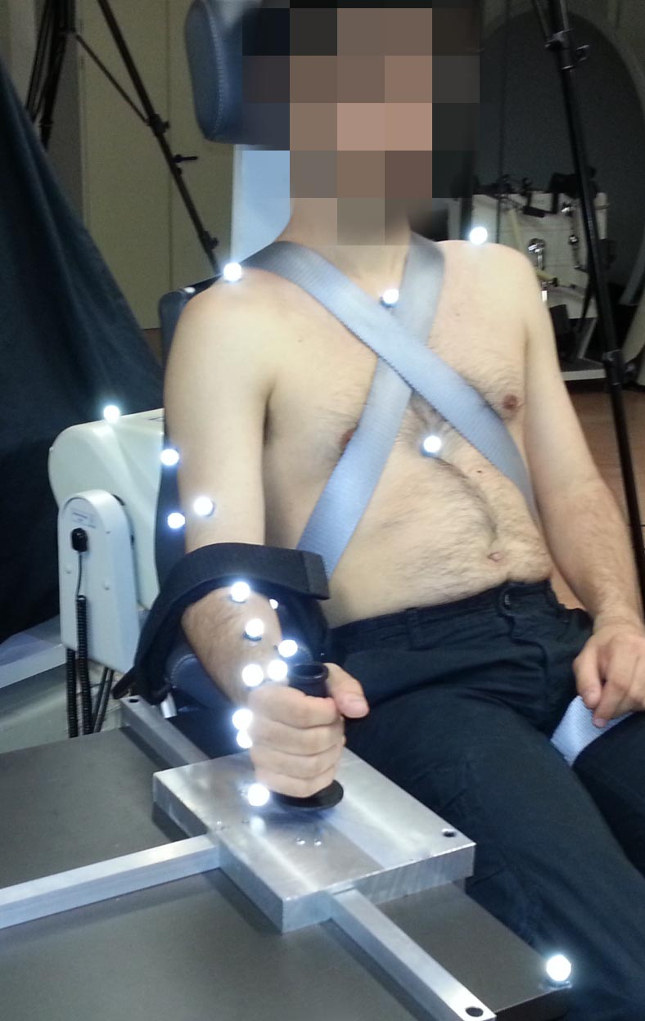
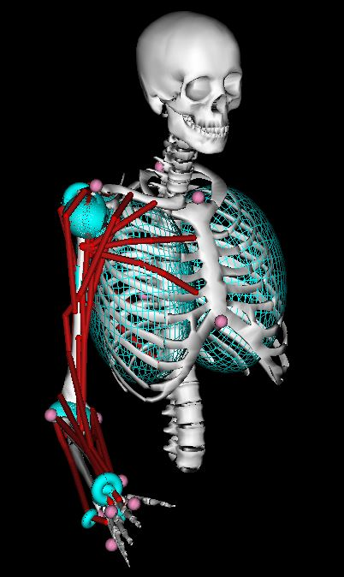
8
Experimental data

Slide 9
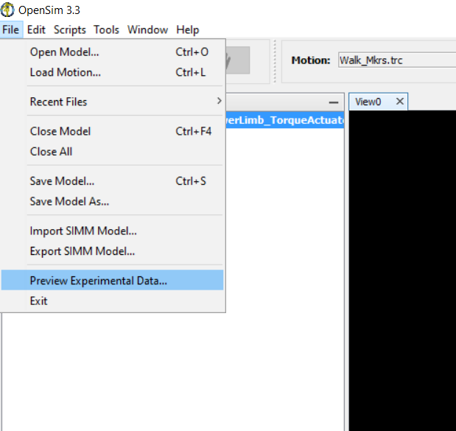
9
Check your markers data

Slide 10
10
Check your markers data

Slide 11
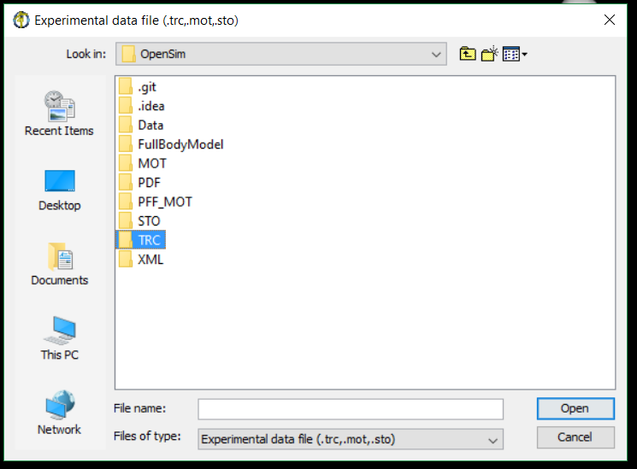
11
Check your markers data

Slide 12
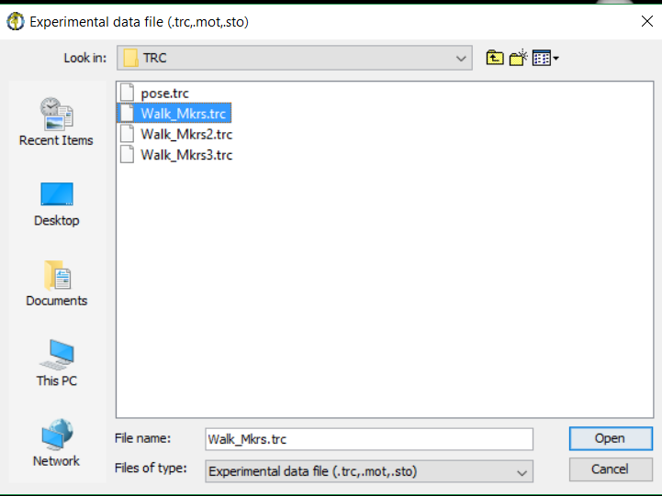
12
Check your markers data

Slide 13
13
Check your force data

Slide 14
14
Check your force data

Slide 15
15
Check your force data

Slide 16
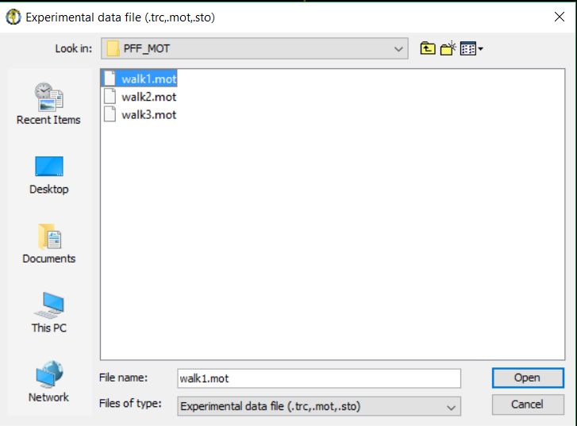
16
Check your force data

